Slide 1


BLACKBUCKS INTERNSHIP REPORT
DISASTER RECOVERY IN AWS
USING CRR&EFS
SUBMITTED BY
Mr. VEMANA AJAY BABU
RegdNo:21B91A04Q4
Mr. TANUKONDA SAI KALYAN
RegdNo:21B91A04N5
Mr. SIRAPU SAI
RegdNo:21B91A04M4
UNDER THE GUIDANCE OF MR. AASHU DEV
B.Tech, AWS solution Architect (2x) certified, AWS Academy Accredited Educator
Blackbuck Engineers Pvt, Ltd Road No 36, Jubilee Hills, Hyderabad

Slide 2
BLACKBUCK INTERNSHIP WORK
Team Members:
VEMANA AJAY BABU (21B91A04Q4)
TANUKONDA SAI KALYAN(21B91A04N5)
SIRAPU SAI(21B91A04M4)
Title:
DISASTER RECOVERY IN AWS USING CRR&EFS
Abstract:
Disaster recovery (DR) is a critical aspect of modern IT infrastructure to ensure business continuity and data integrity in the face of unexpected events. In the context of Amazon Web Services (AWS), disaster recovery mechanisms play a vital role in safeguarding data and applications hosted in the cloud.This abstract highlights two fundamental AWS services utilized for disaster recovery: Cross-Region Replication (CRR) and Amazon Elastic File System (Amazon EFS).

Slide 3
Table of Contents
1.Introduction to Amazon web services (AWS)
1-2
2. Why AWS
2-5
3. AWS global Infrastructure
5-8
4. List of top AWS services
8-18
5. Implementation of disaster recovery in AWS using CRR&EFS
19
5.1. Introduction
19-20
5.2.AWS services used
20
5.3. Rough Architecture
20
5.4. Final Architecture
21
21-22
6. Implementation of the project
22
Service 1:S3bucket
Service 2: CRR
Service 3: VPC
Service 4:EC2
Service 5:EFS
Service 6:IAM Role
22-27
27-30
30-32
33-38
39-42
43-53
54

Slide 4
1
Introduction To Amazon Web Services (AWS):
Amazon Web Services, Inc. (AWS) Amazon Web Services (AWS) is a cloud computing platform that offers a broad set of global compute, storage, database, analytics, application, and deployment services that help organizations move faster, lower IT costs, and scale applications.AWS was launched in 2006 as a suite of web services that runs on the same infrastructure that Amazon.com uses for its e-commerce operations. It has since grown into a comprehensive cloud platform with over 200 services, including compute, storage, databases, analytics, networking, mobile, developer tools, management tools, IoT, security, and enterprise applications.AWS is a pay-as-you-go service, which means that you only pay for the resources that you use. This makes it a cost-effective way to run your applications, especially if you have fluctuating traffic or seasonal spikes in demand.AWS is also a highly scalable platform, which means that you can easily add or remove resources as your needs change. This makes it a good choice for businesses that are growing rapidly or that need to be able to handle large spikes in traffic.AWS is used by a wide range of organizations, including startups, small businesses, large enterprises, government agencies, and educational institutions. Some of the most well-known AWS users include Netflix, Airbnb, Spotify, and The Washington Post.

Slide 5
2
Amazon markets AWS to subscribers as a way of obtaining large-scale computing capacity more quickly and cheaply than building an actual physical server farm. All services are billed based on usage, but each service measures usage in varying ways. As of 2021 Q4, AWS has 33% market share for cloud infrastructure while the next two competitors Microsoft
Azure and Google Cloud have 21%, and 10% respectively, according to Synergy Group.
Uses of AWS:
A small manufacturing organization uses their expertise to expand their business by leaving their IT management to the AWS.
A large enterprise spread across the globe can utilize the AWS to deliver the training to the distributed workforce.
An architecture consulting company can use AWS to get the high compute rendering of construction prototype.
A media company can use the AWS to provide different types of content such as ebox or audio files to the worldwide files.
Why AWS?
There are several reasons why AWS has become a popular choice for cloud computing:
Broad and Comprehensive Service Offering: AWS offers a wide range of services to meet various computing needs. Whether you require computer power, storage, databases, machine learning, analytics, networking, or other capabilities, AWS provides a comprehensive set of services to fulfill these requirements.
Scalability and Flexibility: AWS allows users to scale their resources up or down based on demand. Whether you need to handle a sudden surge in traffic or want to reduce costs during

Slide 6
3
periods of lower activity, AWS provides the flexibility to adjust your resources accordingly. This scalability ensures that your applications can handle varying workloads effectively.
Global Infrastructure: AWS has a vast global infrastructure comprising numerous data centers and availability zones spread across different regions. This infrastructure enables users to deploy their applications and services closer to their target audience, resulting in reduced latency and
improved performance.
Reliability and Availability: AWS has built a reputation for providing highly reliable and available services. With its multiple availability zones and data replication mechanisms, AWS
ensures that your applications and data remain accessible even in the face of hardware failures or
natural disasters. Service Level Agreements (SLAs) guarantee a certain level of uptime for many AWS services.
Security: AWS places a strong emphasis on security. It provides a wide range of security features and tools to help users protect their applications and data. This includes encryption options, network security controls, identity and access management, and compliance certifications. AWS adheres to industry best practices to maintain a secure environment for its customers.
Integration and Ecosystem: AWS integrates well with various third-party tools, technologies, and services. It offers extensive APIs and SDKs, making it easier to integrate AWS services into existing applications or build new solutions from scratch. The AWS ecosystem also includes a vibrant community, documentation, training resources, and support services, facilitating development and troubleshooting.
Cost-Effectiveness: AWS follows a pay-as-you-go pricing model, allowing users to pay only for the resources they consume. This eliminates the need for upfront investments in hardware and infrastructure. Additionally, AWS provides cost optimization tools and features to help users
monitor and control their spending, ensuring cost-effectiveness.
Innovation and Continuous Improvement: AWS continues to innovate and expand its services, introducing new capabilities and features regularly. It invests heavily in research and
development to stay at the forefront of cloud technology. This commitment to innovation ensures that users have access to the latest tools and advancements in cloud computing.

Slide 7
4
These factors, among others, contribute to the popularity and success of AWS as a cloud computing provider. However, it's important to note that the choice of cloud provider should be based on your specific needs, requirements, and preferences. It's worth evaluating multiple cloud platforms to determine the best fit for your organization.
Advantages of AWS:
Flexibility
Cost-effectiveness
Scalability/Elasticity
Security
Flexibility
We can get more time for core business tasks due to the instant availability of new features and services in AWS.
It provides effortless hosting of legacy applications. AWS does not require learning new technologies and migration of applications to the AWS provides advanced computing and efficient storage.
AWS also offers a choice that whether we want to run the applications and services together or not. We can also choose to run a part of the IT infrastructure in AWS and the remaining part in data centers.
Cost-effectiveness
AWS requires no upfront investment, long-term commitment, and minimum expense when compared to traditional IT infrastructure that requires a huge investment.
Scalability/Elasticity
Through AWS, autoscaling and elastic load balancing techniques are automatically scaled up or down, when demand increases or decreases respectively. AWS techniques are ideal for handling

Slide 8
5
unpredictable or very high loads. Due to this reason, organizations enjoy the benefits of reduced cost and increased user satisfaction.
Security
AWS provides end-to-end security and privacy to customers.
AWS has a virtual infrastructure that offers optimum availability while managing full privacy and isolation of their operations.
Customers can expect high-level physical security because of Amazon's several years of experience in designing, developing, and maintaining large-scale IT operation centers.
AWS ensures the three aspects of security, i.e., Confidentiality, integrity, and availability of users.
AWS Global Infrastructure
AWS is a cloud computing platform which is globally available.
Global infrastructure is a region around the world in which AWS is based. Global infrastructure is a bunch of high-level IT services which is shown below:
AWS is available in 19 regions, and 57 availability zones in December 2018 and 5 more regions 15 more availability zones for 2019.
The following are the components that make up the AWS infrastructure:
Availability Zones
Region
Edge locations
Regional Edge Caches

Slide 9
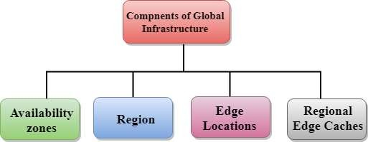
6
In Amazon Web Services (AWS), an Availability Zone (AZ) refers to a distinct, physically separate data center within a specific region. AZs are designed to provide fault tolerance and high availability by isolating failures and minimizing the impact of any disruption.
Each AZ is equipped with independent power, cooling, networking infrastructure, and is connected to other AZs within the same region through high-speed, low-latency links. They are strategically located to minimize the risk of natural disasters affecting multiple zones simultaneously.
By distributing resources across multiple AZs, you can design highly reliable and resilient architectures in AWS. When you launch resources like EC2 instances, databases, or storage volumes, you have the option to select the AZ in which they should be provisioned.
The primary benefits of utilizing Availability Zones in AWS include:
Fault tolerance: By deploying resources in different AZs, you protect your applications from single points of failure. If one AZ experiences an issue, your applications can continue running in other AZs, ensuring minimal downtime.
High availability: Distributing resources across AZs allows you to achieve high availability for your applications. Services like load balancers can be configured to route traffic across multiple AZs, automatically diverting traffic to healthy instances if one AZ becomes unavailable.

Slide 10
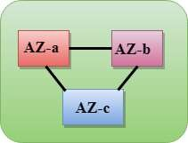
7
Availability zone as a Data Center
An availability zone is a facility that can be somewhere in a country or in a city. Inside this
facility, i.e., Data Centre, we can have multiple servers, switches, load balancing, firewalls. The things which interact with the cloud sit inside the data centers.
An availability zone can be a several data centers, but if they are close together, they are counted as 1 availability zone.
Region
A region is a geographical area. Each region consists of 2 more availability zones.
A region is a collection of data centers which are completely isolated from other regions.
A region consists of more than two availability zones connected to each other through links.
Availability zones are connected through redundant and isolated metro fibers.
Edge Locations
Edge locations are the endpoints for AWS used for caching content.
Edge locations consist of CloudFront and Amazon's Content Delivery Network (CDN).
Edge locations are more than regions. Currently, there are over 150 edge locations.
Edge location is not a region but a small location that AWS have. It is used for caching the content.
Edge locations are mainly located in most of the major cities to distribute the content to
end users with reduced latency.
For example, some user accesses your website from Singapore; then this request would be redirected to the edge location closest to Singapore where cached data can be read.

Slide 11

8
Regional Edge Cache
AWS announced a new type of edge location in November 2016, known as a Regional Edge Cache.
Regional Edge cache lies between CloudFront Origin servers and the edge locations.
A regional edge cache has a larger cache than an individual edge location.
Data is removed from the cache at the edge location while the data is retained at the Regional Edge Caches.
When the user requests the data, then data is no longer available at the edge location. Therefore,
the edge location retrieves the cached data from the regional edge cache instead of the Origin servers that have high latency.
List of top AWS Services:
AWS is the widely used cloud platform worldwide, from start-ups to large enterprises. Though AWS services were introduced to the market by 2006, their revenue from Public Cloud SaaS has hit 145.5 billion USD by 2021. Presently, Amazon Web Services are a one-stop solution for all cloud services ranging from data storage to analytics. AWS services provide easy, simple, cost- effective cloud services, which drive businesses to achieve increased efficiency and performance. Besides, these services have many more features to serve customers in multiple ways.
Now, let's have a look at the most popular AWS services in 2023. In this blog, you can learn what is the objective, features, and benefits of each AWS service.
Here is the list of Top 30 AWS Services List:
1.Amazon EC2 [Elastic Compute Cloud]
Amazon EC2 is one of the fastest-growing cloud computing AWS services, which offers virtual servers to manage any kind of workload. It facilitates the computing infrastructure with the best suitable processors, networking facilities, and storage systems. As a result, it supports adapting to the workloads precisely. Amazon EC2 provides a highly secure, reliable, performing computing infrastructure meeting business demands. And it helps you to access resources quickly and dynamically scale capacities as per demands.

Slide 12



9
2. Amazon S3
Another popular addition to the AWS services list is Amazon S3, which is an object storage AWS service, which is highly scalable. It mainly helps users to access any quantity of data from anywhere. Here, data is stored in ‘storage classes’ to reduce costs without any extra investment and manage it comfortably. The data is highly secure and supports meeting audit and compliance requirements. You can handle any volume of data with Amazon S3’s robust access controls, replication tools, and higher visibility. Moreover, it supports maintaining data version controls and preventing accidental deletion.
3. AWS Aurora
Amazon Aurora is the next addition to this list of top AWS services in demand. Why? It is a MySQL and PostgreSQL compatible relational database with high performance. Believe it or not, it is five times faster than standard MySQL databases. And it allows for automating crucial tasks such as hardware provisioning, database setup and backups, and patching. Amazon Aurora is a distributed, fault-tolerant, self-healing storage system that could scale automatically as per needs. Besides, you can even reduce costs significantly and enhance databases' security, availability, and reliability.
4. Amazon DynamoDB
DynamoDB is a promising addition to this list of AWS services. DynamoDB is a fully managed and serverless NoSQL database AWS service. And it is a fast and flexible database system that provides innovative opportunities to developers at low costs. It gives you single-digit millisecond performance with unlimited throughput and storage. DynamoDB has in-built tools to generate actionable insights, useful analytics, and monitor traffic trends in applications.

Slide 13



10
5. Amazon RDS
Amazon RDS would be the next entry in this discussion on AWS services. Amazon RDS is the managed Relational Database AWS Service (RDS) for MySQL, PostgreSQL, Oracle, SQL Server, and MariaDB. It allows the setup, operation, and scale of a relational database in the cloud quickly. Also, it achieves high performance by automating the tasks such as hardware provisioning, database setup, patching, and backups. When you use Amazon RDS, you don’t need to install and maintain the database software. Overall, you can optimize costs by embracing this service and achieve high availability, security, and compatibility for your resources.
6. Amazon Lambda
AWS Lambda is also a promising addition to the list of AWS services. Amazon Lambda is a serverless and event-driven computing AWS service. It helps to run codes automatically without worrying about servers and clusters. Simply put, codes can be uploaded directly to run without worrying about provisioning or managing infrastructure. So, this service automatically accepts 'code execution requests' irrespective of its scale. Besides, you can pay the price only for the computer time, so AWS Lambda makes effective cost-control.
7. Amazon VPC
Amazon VPC is the Virtual Private Cloud, which is an isolated cloud resource. It controls the virtual networking environment, such as resource placement, connectivity, and security. And it allows you to build and manage compatible VPC networks across cloud AWS resources and on- premise resources. Here, it improves security by applying rules for inbound and outbound connections. Also, it monitors VPC flow logs delivered to Amazon S3 and Amazon Cloudwatch to gain visibility over network dependencies and traffic patterns. Amazon VPC also detects anomalies in the patterns, prevents data leakage, and troubleshoots network connectivity and configuration issues.

Slide 14



11
8. Amazon CloudFront
Amazon CloudFront is another credible mention in the list of renowned Amazon Web Services. This AWS service delivers content globally, which offers high performance and security.
Mainly, it delivers data with high speed and low latency. Here, content is delivered to destinations successfully with automated network mapping and intelligent routing mechanisms. The security of data is enhanced with traffic encryption methods and access controls. Also, data can be transferred within milliseconds with its in-built data compression, edge computing capabilities, and field-level encryption. Besides, you gear up streaming high-quality video using AWS media services to any device quickly and consistently using Amazon CloudFront.
9. AWS Elastic Beanstalk
This AWS service supports running and managing web applications. Elastic Beanstalk allows for the easy deployment of applications from capacity provisioning, load balancing, and auto- scaling to application health monitoring. With its auto-scaling properties, this service simplifies demands in scaling to adjust to the needs of the business. It helps to manage peaks in workloads and traffic with minimum costs. Basically, AWS Elastic Beanstalk is a developer-friendly tool since it manages servers, load balancers, firewalls, and networks simply. As a result, this service allows developers to show much more focus on coding.
10. Amazon EC2 Auto-scaling
This AWS service scales computing capacity to meet the demands accurately. And it is achieved by adding or removing EC2 instances automatically. There are two types of scaling such as dynamic scaling and predictive scaling. Here, dynamic scaling responds to the presently changing demands, whereas predictive scaling responds based on predictions. Through Amazon EC2 Auto-scaling, you can identify the unhealthy EC2 instances, terminate them, and replace them with new instances.

Slide 15


12
11. Amazon ElastiCache
Amazon ElastiCache is a fully managed, flexible, in-memory caching AWS service. It supports increasing the performance of your applications and database. And this service helps to reduce the load in a database by caching data in memory. Amazon ElastiCache accesses data from in- memory with high speed, microsecond latency, and high throughput. With a self-managed cache service, you can reduce costs and eliminate the operational overhead of your business.
12. Amazon S3 Glacier
Amazon S3 Glacier is the archive storage in the cloud at a low cost. It is built with three storage classes such as S3 Glacier instant retrieval, flexible retrieval, and deep archive. Here, the instant class supports immediate access to data, and the flexible class allows flexible access within minutes to hours with no cost. The third one, deep archive, helps archive compliance data and digital media. Overall, they support you to access data from archives faster.
13. Amazon LightSail
Amazon LightSail is the website and applications building AWS service. This service offers Virtual Private Server instances, containers, databases, and storage. It allows a serverless computing service with AWS Lambda. With Amazon LightSail, you can create websites using pre-configured applications such as WordPress, Magento, Prestashop, and Joomla in a few clicks and at a low cost. In addition to this, it is the best tool for testing, so you can create, test, and delete sandboxes with your new ideas.

Slide 16



13
14. Amazon Sagemaker
Amazon Sagemaker is the AWS service that allows building, training, and deploying Machine Learning (ML) models at a large capacity. It is an analytical tool that functions based on Machine Learning power to analyze data more efficiently. With its single toolset, you can build high-quality ML models quickly. Amazon Sagemaker not only generates reports but provides the purpose for generating predictions too. In addition, Amazon Ground Truth Plus creates datasets without labeling applications.
15. Amazon SNS
It is the Amazon Simple Notification Service (SNS). It is a messaging service between Application to Application (A2P) and Application to Person (A2Person). Here, A2P helps many-to-many messaging between distributed systems, microservices, and event-driven serverless applications. And A2P supports applications to send messages to many users via mail, SMS, etc. For instance, you can send up to ten messages in a single API request. With effective filtering systems, subscribers will receive messages that they are interested in.
Besides, Amazon SNS works alongside Amazon SQS to deliver messages accurately and consistently.
16. Amazon EBS
Amazon Elastic Block Store (EBS) is a block storage service. It supports scaling high- performance workloads such as SAP, Oracle, and Microsoft products. And it provides better

Slide 17



14
protection against failures up to 99.999%. It helps to resize clusters for big data analytics engines such as Hadoop and Spark. Also, you can build storage volumes, optimize storage performance, and reduce costs. Amazon EBS’s lifecycle management creates policies that help create and manage backups effectively.
17. Amazon Kinesis
It is the AWS service that analyses video as well as data streams. Amazon Kinesis collects, processes, and analyzes all types of streaming data. Here, the data may be audio, video, application logs, website clickstreams, and IoT telemetry. Then, it generates real-time insights within seconds once the data has arrived. With the help of Amazon Kinesis, you could stream and process a large quantity of real-time data with low latencies, very simply.
18. Amazon Elastic File System (EFS)
Amazon EFS is the fully managed file system for Amazon EC2. And it is a simple and serverless elastic file system. You can create and configure file systems without provisioning, deploying, patching, and maintenance using Amazon EFS. Here, files can be added and deleted as per the scaling needs. Especially, you can pay only for the used space, hence this service helps to reduce costs.

Slide 18



15
19. AWS IAM
It is the Identity and Access Management (IAM) service offered by AWS to securely access the applications and resources. It regulates access to various resources based on roles and access policies; as a result, you can achieve a fine-grained access control on your resources. The AWS IAM access analyzer helps streamline permission management through setting, verifying, and refining. In addition, AWS IAM attribute-based access control helps create fine-grained permissions based on user attributes such as department, job role, team name, etc.
20. Amazon SQS
Amazon SQS is a fully managed message queuing service. There are two types of message queuing services: SQS Standard and SQS FIFO. Here, the SQS standard offers features such as maximum throughput, best-effort ordering, and quick delivery. And SQS FIFO processes messages only once in the same order by which they have been sent. Also, Amazon SQS allows decoupling or scaling microservices, distributed systems, and serverless applications. It helps you send, receive, and manage messages in a large volume. Moreover, there is no need to install and maintain other messaging software, reducing costs significantly. Besides, scaling is carried out quickly and automatically in this service.
21. Amazon RedShift
Amazon Redshift is a quick, simple, and cost-effective data warehousing service. You can gain insights about cloud data warehousing in an easy, faster, and more secure way. It allows analysis of all the data in operational databases, data lakes, data warehouses, and third-party data. And Amazon Redshift helps analyze a large volume of data and run complex analytical queries. With its automation capabilities, this service increases query speed and provides the best price performance.

Slide 19


16
22. Amazon Cloudwatch
This AWS service monitors the cloud resources and applications keenly. It is a single platform that helps to monitor all AWS resources and applications; it increases visibility to respond to issues quickly. Mainly, Amazon Cloudwatch provides actionable insights to optimize monitoring applications, systemwide performance changes, and resource utilization. And you can get a complete view of the health of AWS resources, applications, and services running on AWS and on-premises. In addition, Amazon CloudWatch helps to detect anomalies in the behavior of the cloud environment, set alarms, visualize logs and metrics, make automated actions, troubleshoot issues, and discover insights.
23. Amazon Chime
Amazon Chime is a communication service. It is a single solution that offers audio calling, video calling, and screen sharing capabilities. With the help of this service, you can make quality meetings, chat, and video calls both inside and outside of your organization. And more features can be added to this service as per your business needs. Mainly, you can set calls for a pre- defined time to automatically make calls on time. Amazon Chime helps you not to miss a meeting amidst your hectic schedule at work. Besides, you can pay as per the usage of resources by which you can reduce the costs significantly.
24. Amazon Cognito
It is the identity management AWS service. Amazon Cognito manages identities for accessing your applications and resources. Mainly, this service helps to add sign-in, sign-up, and access control the web and mobile apps quickly. It can support millions of users to sign in with familiar applications such as Apple, Facebook, Google, and Amazon. In Amazon Cognito, the feature ‘Cognito user pools’ can be set up quickly without any infrastructure, and the pool members will have a directory profile. It supports multi-factor authentication and encryption of data-at-rest and data-in-transit.

Slide 20



17
25. Amazon Inspector
Amazon Inspector is an automated vulnerability management service. This service offers continuous and automated vulnerability management for Amazon EC2 and Amazon ECR. It allows scanning AWS workloads for software vulnerabilities and unwanted network exposure. Amazon Inspector quickly identifies vulnerabilities, which helps to take immediate actions to resolve them before it worsens the applications. Moreover, it supports meeting compliance requirements and reduces meantime-to-remediate vulnerabilities. And it provides you with accurate risk scores and streamlined workflow.
26. AWS Firewall Manager
It is the central management service of firewall rules. The firewall manager supports managing firewall rules across all the applications and accounts. The common security rules help to manage new applications included over time. It is the one-time solution for consistently creating firewall rules and security policies and implementing them across the infrastructure. AWS firewall manager helps you audit VPC security groups for compliance requirements and control network traffic effectively.
27. Amazon Appflow
Amazon Appflow is a no-code service that allows the integration of SaaS applications and AWS services effortlessly. To be more precise, it securely automates dataflows integrating third-party applications and AWS services without using codes. You can transfer data between SaaS applications such as Salesforce, SAP, Zendesk, etc. since

Slide 21




18
Amazon Appflow can be integrated with other applications in a few clicks. Especially, a large volume of data can be moved without breaking it up into batches using this service.
28. Amazon Route 53
It is a scalable cloud Domain Name System (DNS) service. It allows end-users to connect with Amazon EC2, Elastic load balancers, Amazon S3 buckets, and even outside AWS. In this service, the feature ‘Route 53 application recovery controllers’ configure DNS health checks and helps to monitor the ability of systems to recover from failures. And ‘Route 53 traffic flow’ helps manage traffic across the globe using routing methods such as latency-based routing, Geo DNS,
Geoproximity, and weighted round-robin.
29. AWS Cloud Formation
This AWS service creates and manages resources with templates. It is a single platform that can handle all AWS accounts across the globe. It automates resource management with AWS service integration and offers turnkey application distribution and governance controls. Also, AWS Cloud Formation can automate, test, and deploy infrastructure with continuous integration and delivery. And you can run applications right from AWS EC2 to complex multi-region applications using this service.
30. AWS Key Management Service (KMS)
AWS KMS manages the creation and control of encryption keys. It means that AWS KMS creates cryptographic keys and controls their uses across various applications. You can achieve a secure and resilient service using hardware resilient modules to protect keys. This service can be integrated with AWS Cloudtrail to provide logs of all key usage to precisely fulfil compliance and regulatory requirements.

Slide 22
19
IMPLEMENTATION OF DISASTER RECOVERY IN AWS USING CRR AND EFS
INTRODUCTION:
Disaster recovery (DR) is a critical aspect of modern IT infrastructure to ensure business continuity and data integrity in the face of unexpected events. In the context of Amazon Web Services (AWS), disaster recovery mechanisms play a vital role in safeguarding data and applications hosted in the cloud.
Amazon Simple Storage Service (Amazon S3) Cross-Region Replication (CRR) and Amazon Elastic File System (Amazon EFS) Replication can be used to create a disaster recovery (DR) solution in AWS.Amazon S3 CRRAmazon S3 CRR asynchronously replicates objects in an Amazon S3 bucket in one AWS Region to an S3 bucket in another AWS Region. This ensures that you have a copy of your data in a different Region in case of a disaster that affects your primary Region.Amazon EFS ReplicationAmazon EFS Replication automatically maintains copies of your Amazon EFS file systems for business continuity or to help you meet compliance requirements as part of your DR strategy. You can set up replication for new or existing EFS file systems, with replication either within a single AWS Region or between two AWS Regions in the same AWS partition.

Slide 23
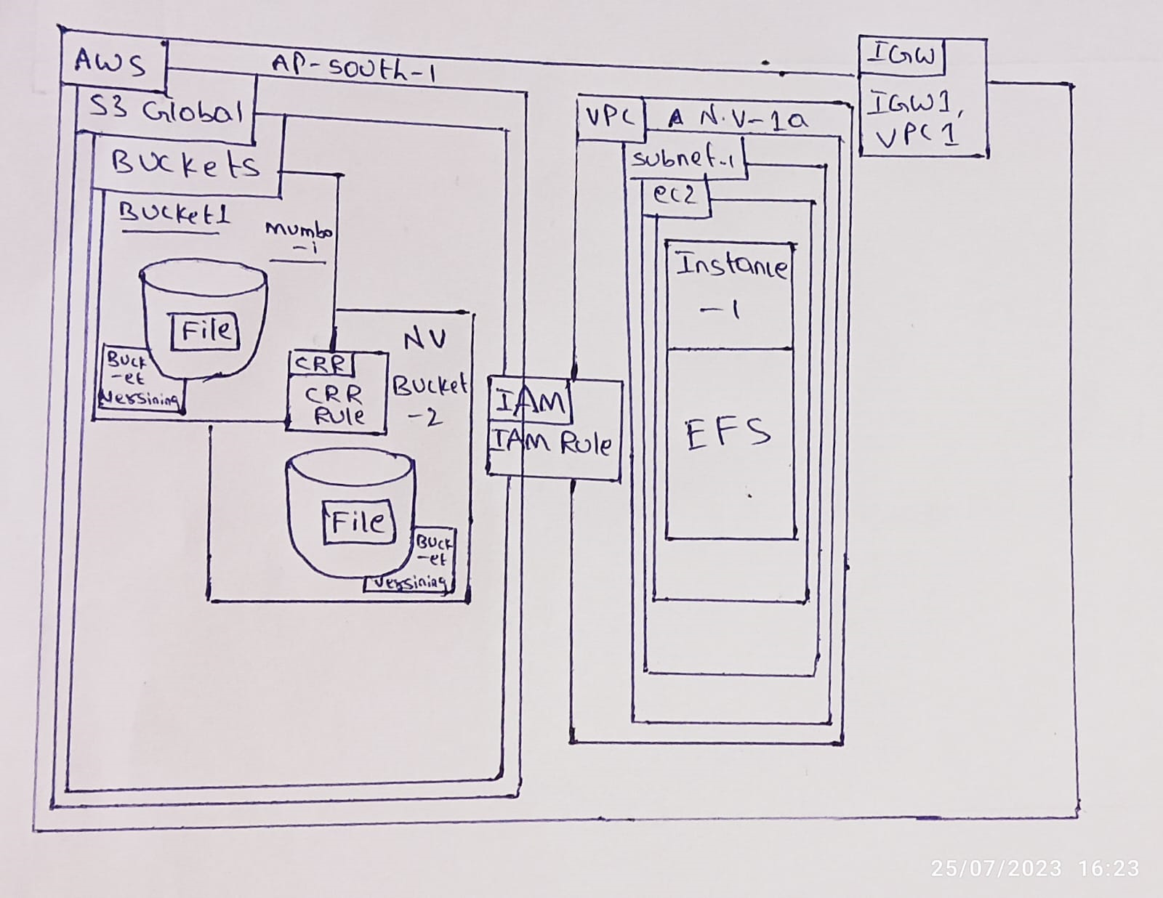
20
CRR and EFS Replication are a powerful combination that can be used to create a cost-effective and reliable DR solution in AWS.
AWS Services Used:
S3 bucket
Elastic Compute Cloud(EC2)
Identity and Access Management(IAM)
CRR
EFS
f .VPC
Rough Architecture:

Slide 24
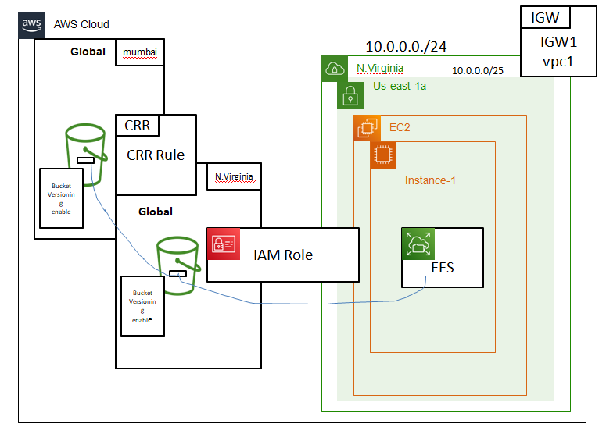
21
Final architect:

Slide 25

22
.
Implementation of the Project
Service 1: source bucket in mumbai
To create a bucket with the name "bucket1mub," follow these steps:
Sign into the AWS Management Console.
Open the s3 source.
Click on the "Create Bucket" option.
Give the bucket name as bucket1mub
Click on create bucket

Slide 26
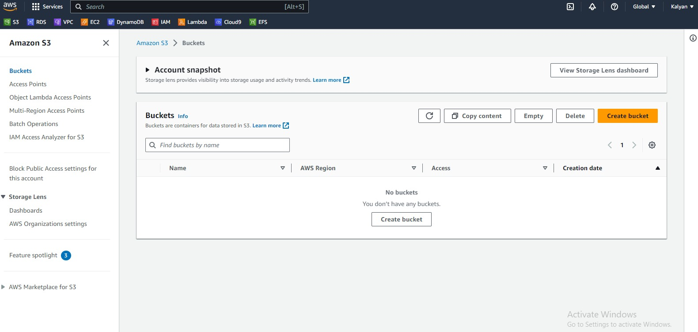
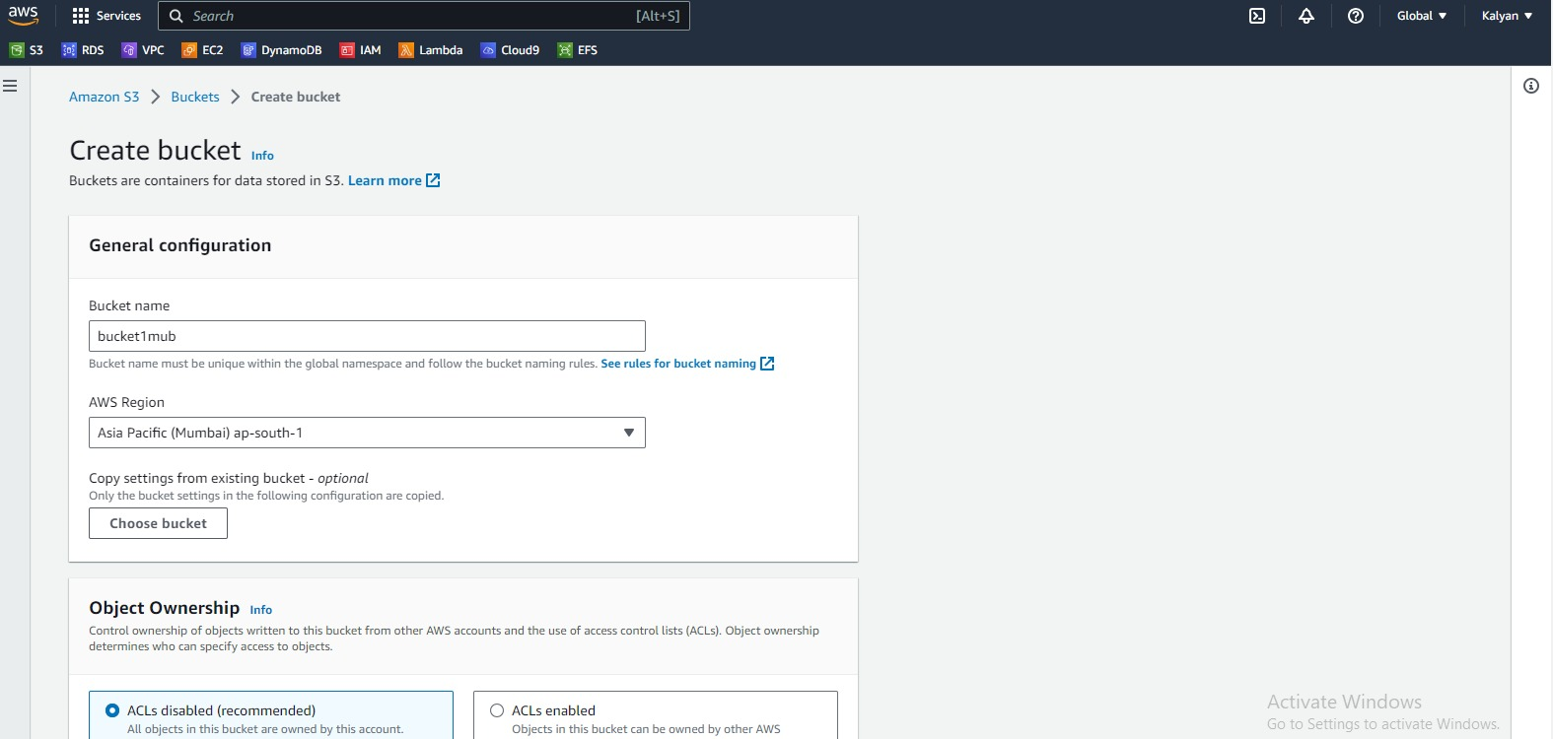
23
Creating bucket in mumbai region

Slide 27
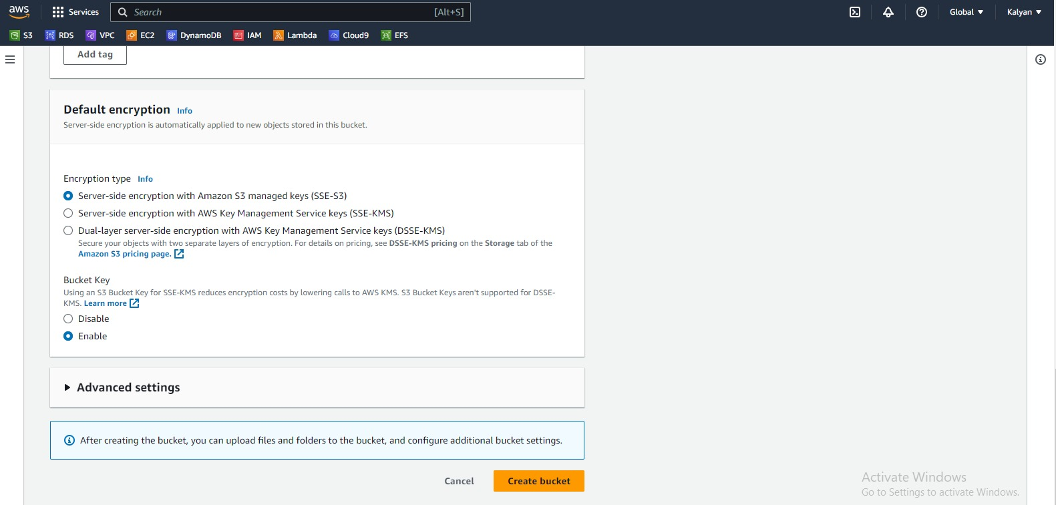
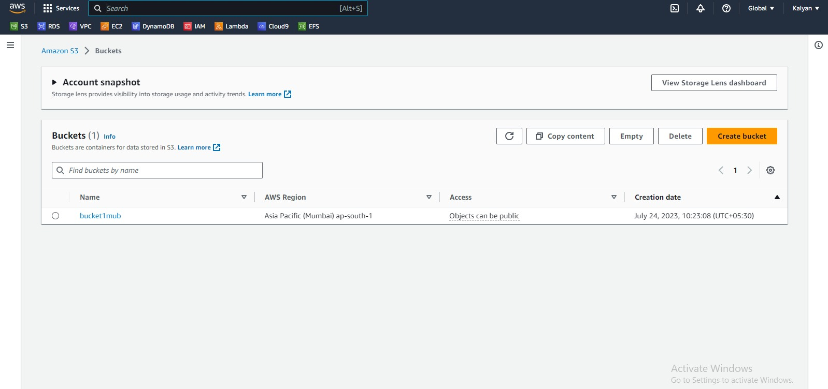
24

Slide 28
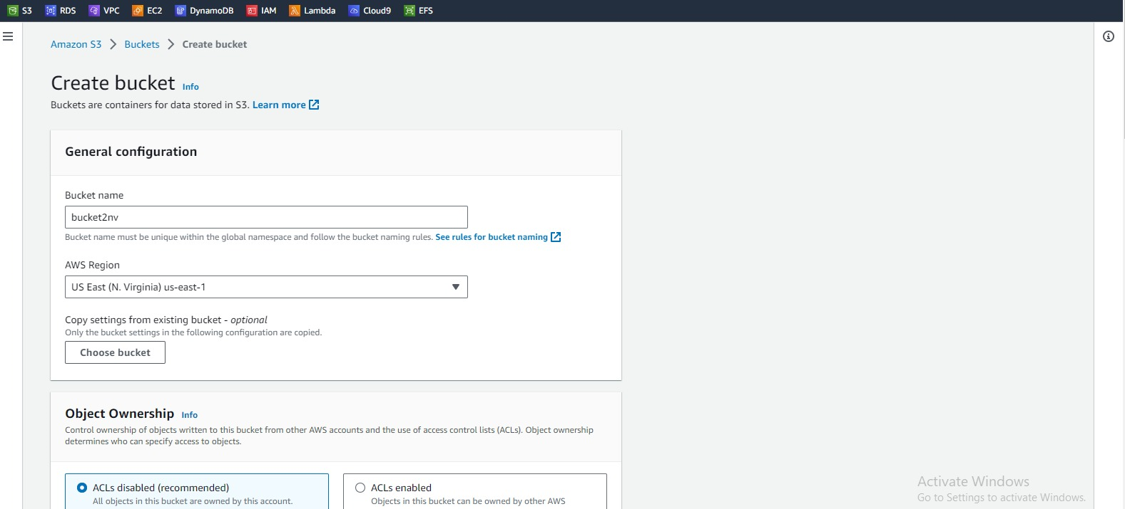
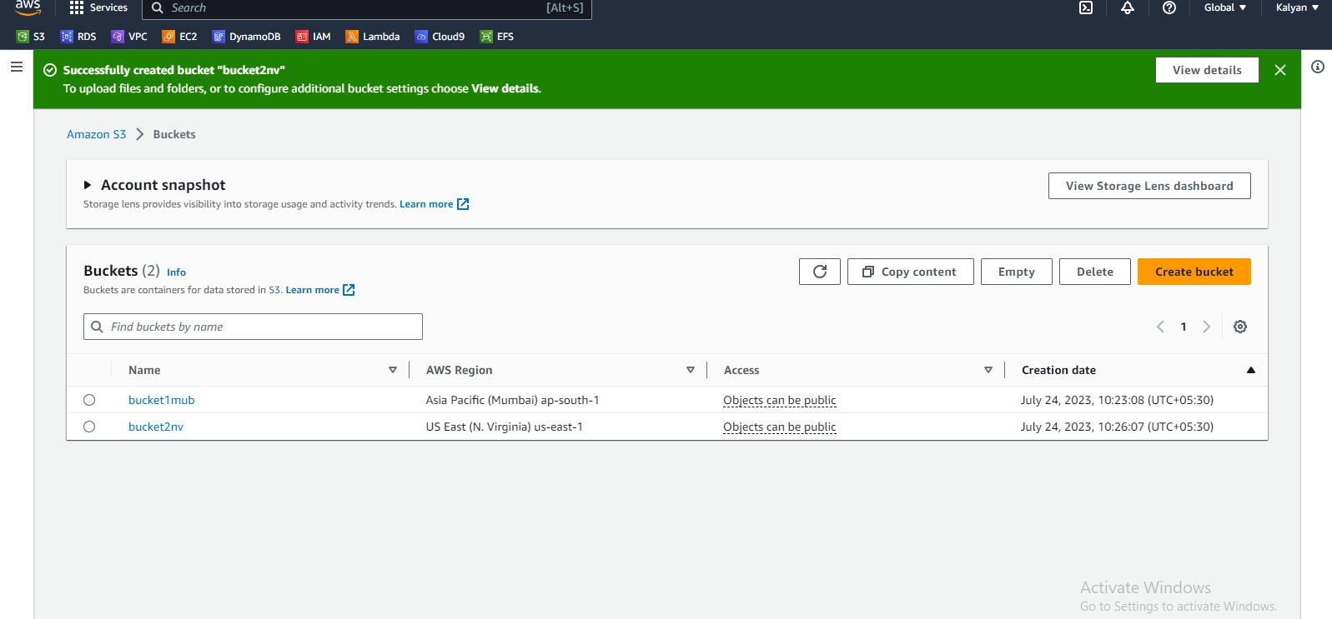
25
Creating bucket in northern virginia

Slide 29
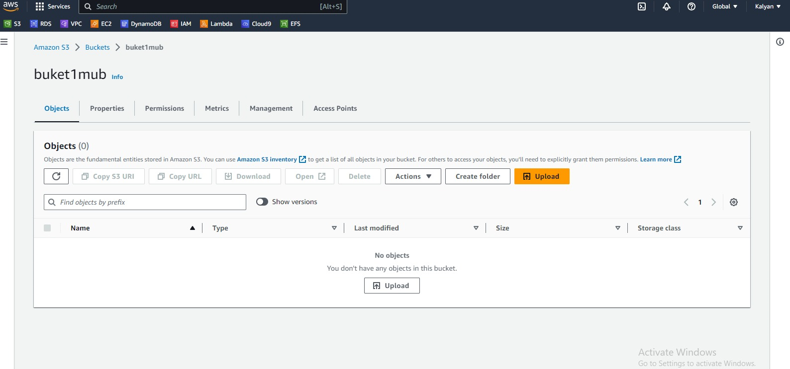
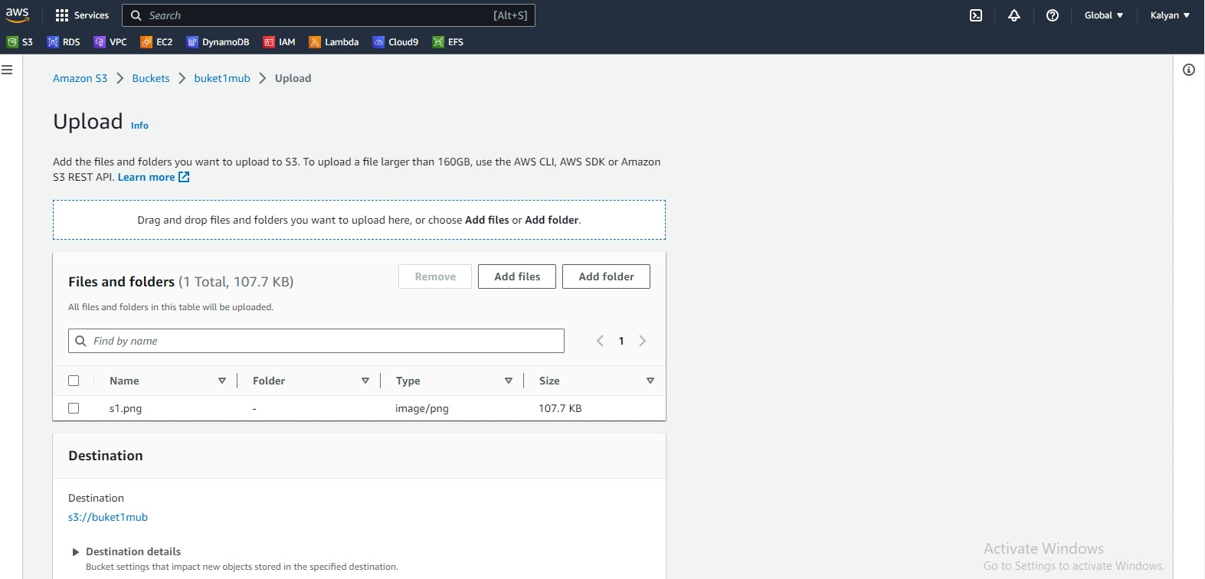
26
.uploading a file to bucket1
sucessfully uploading the file

Slide 30
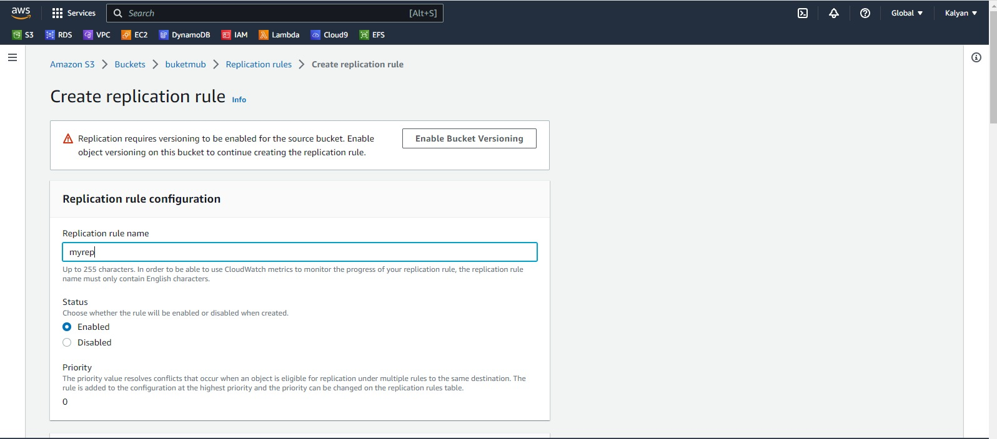
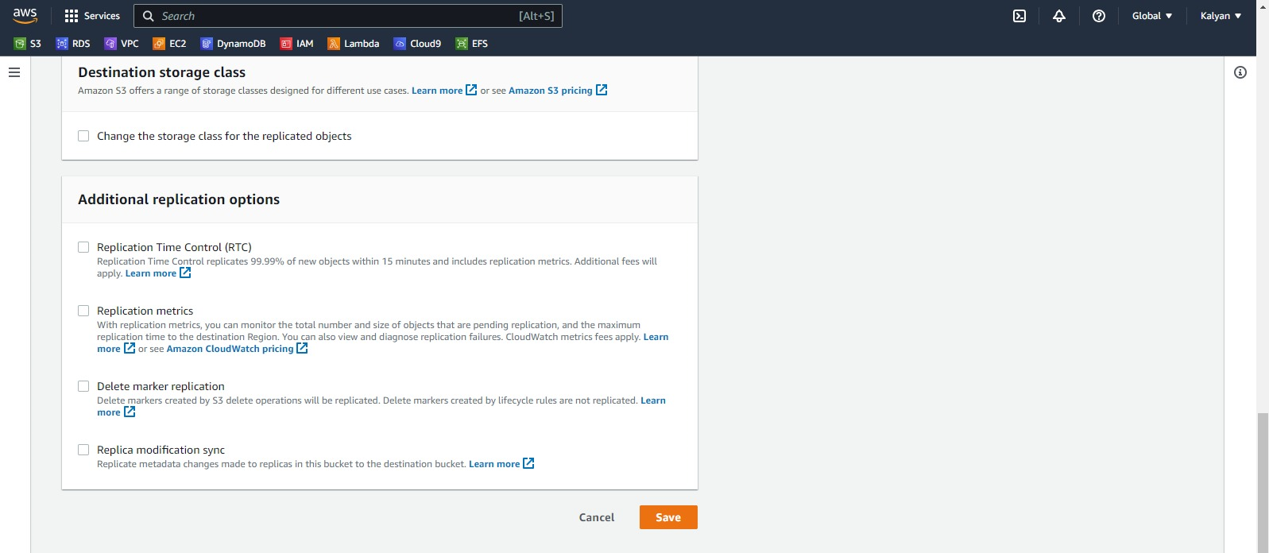
27
Service:2 –CRR
Create replication rule in mumbai

Slide 31
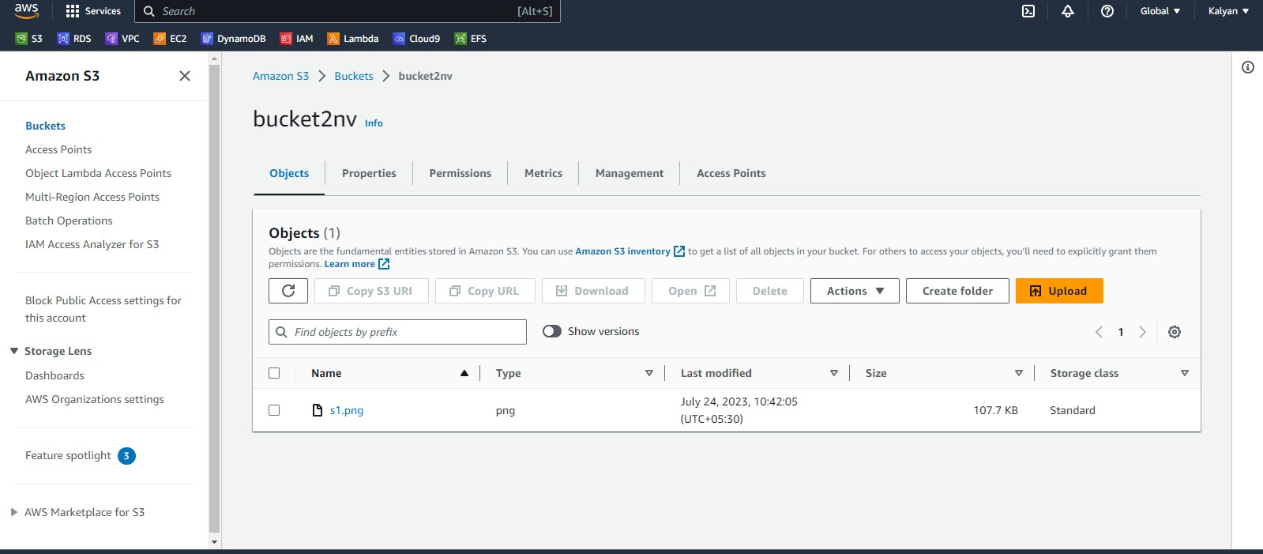

28
.
If two buckets are created in two different regions like mumbai and northern virginia the file will be uploaded in mumbai region
After applying CRR rule the file will be able to get the file in nothern virginia also
Service:3- VPC
To create a VPC name as “VPC NV” and CIDR value as 10.0.0.0/24

Slide 32
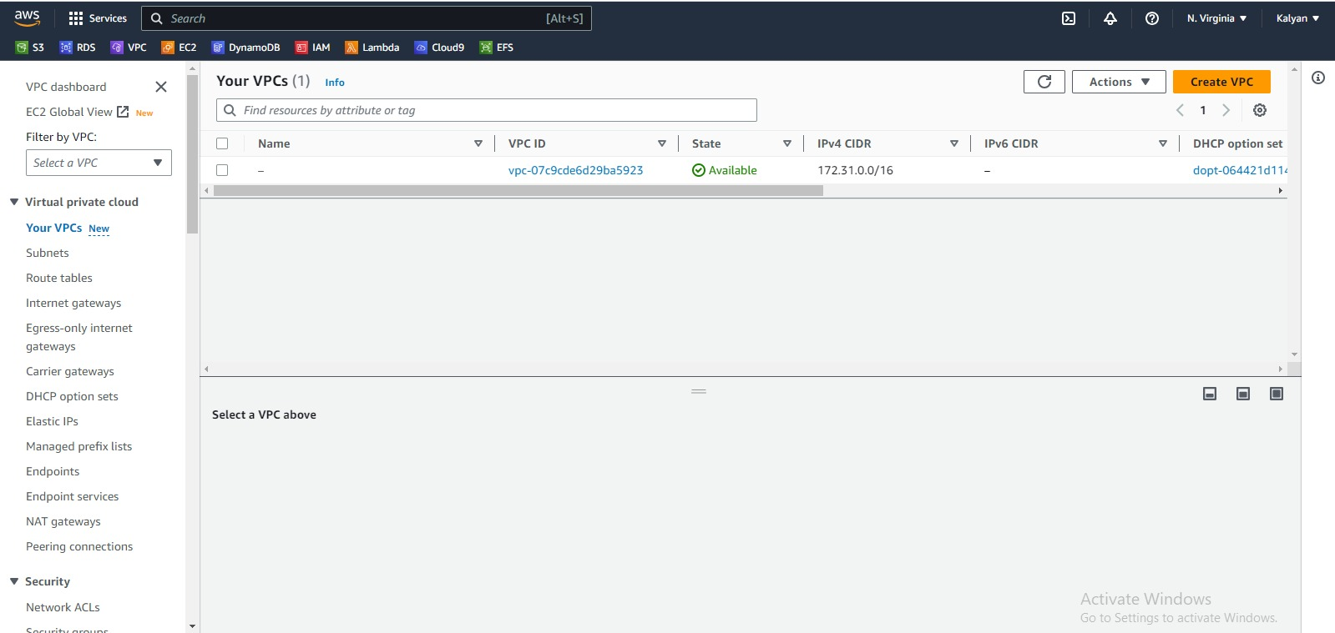
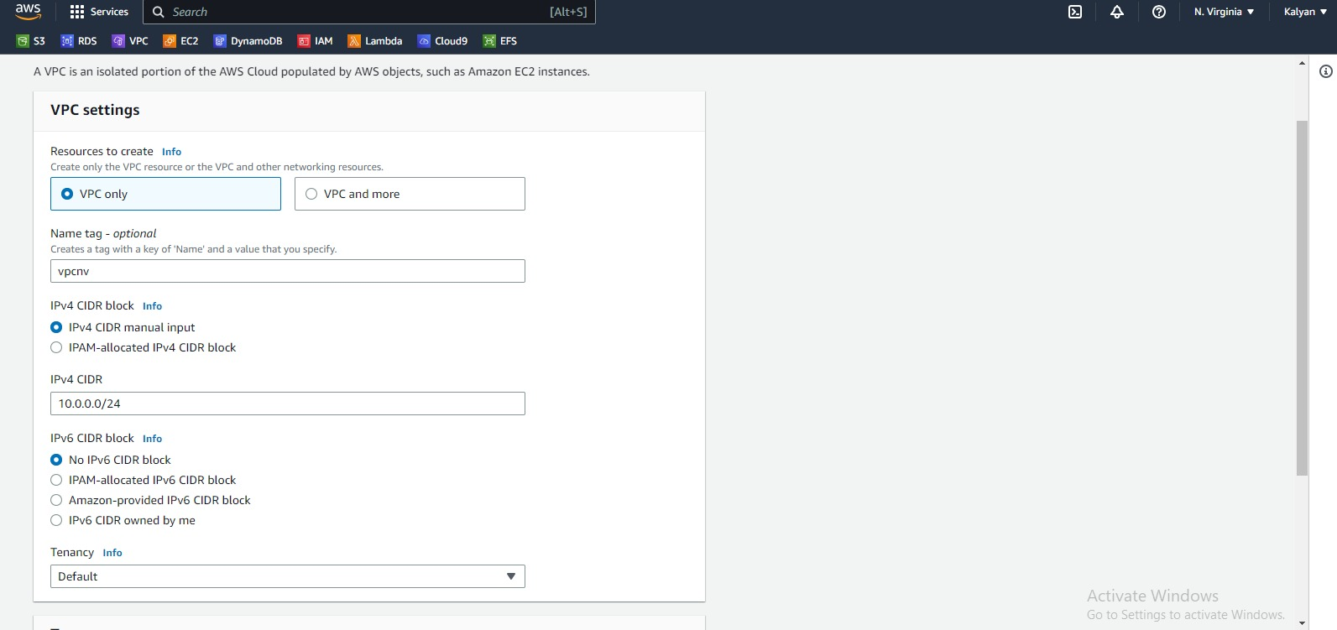
29
Select virtual private cloud(vpc)
Creating vpc

Slide 33
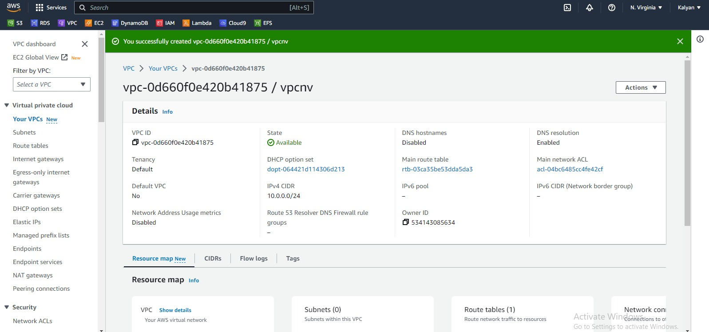
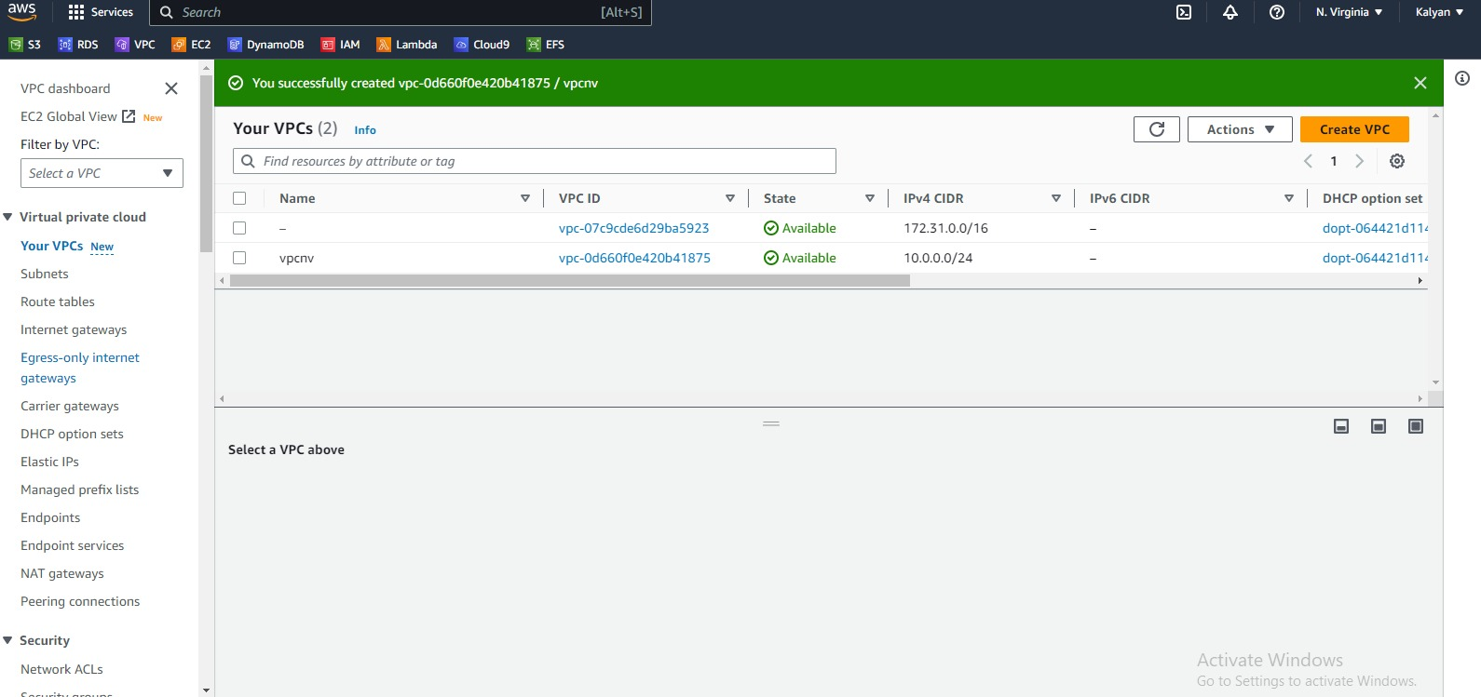
30

Slide 34
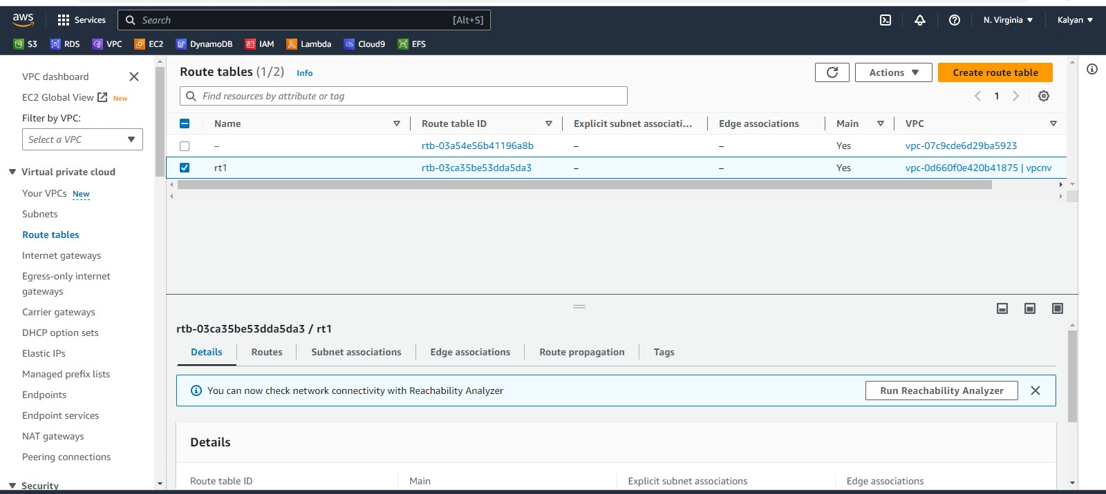
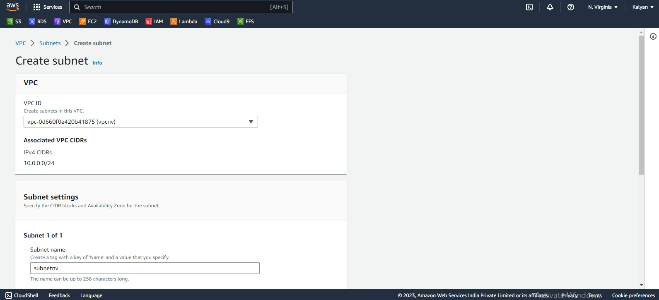
31
Go to route table edit the name as rt1vpcnv creating along with vpc
Create a subnet with CIDR 10.0.0.0/25

Slide 35
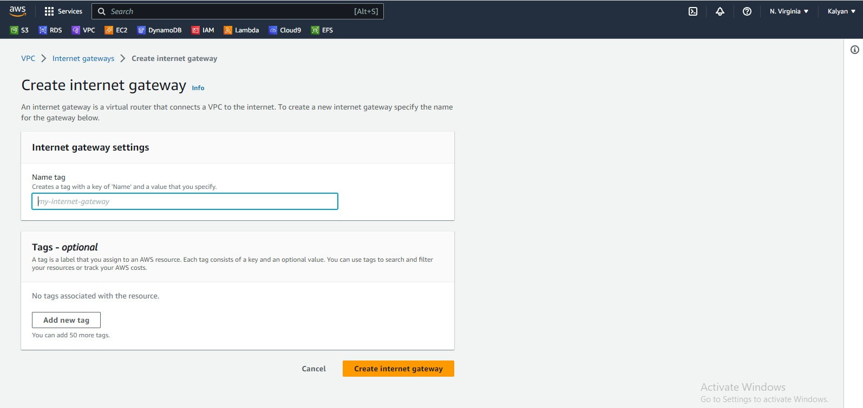
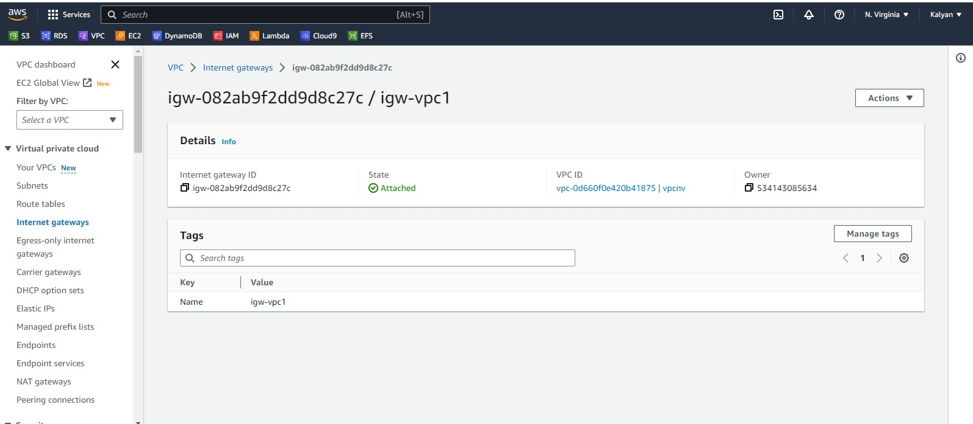
32
Creating internet gateway

Slide 36
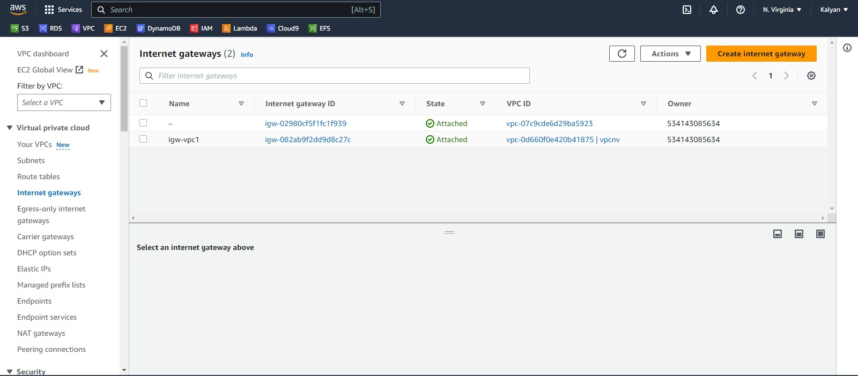
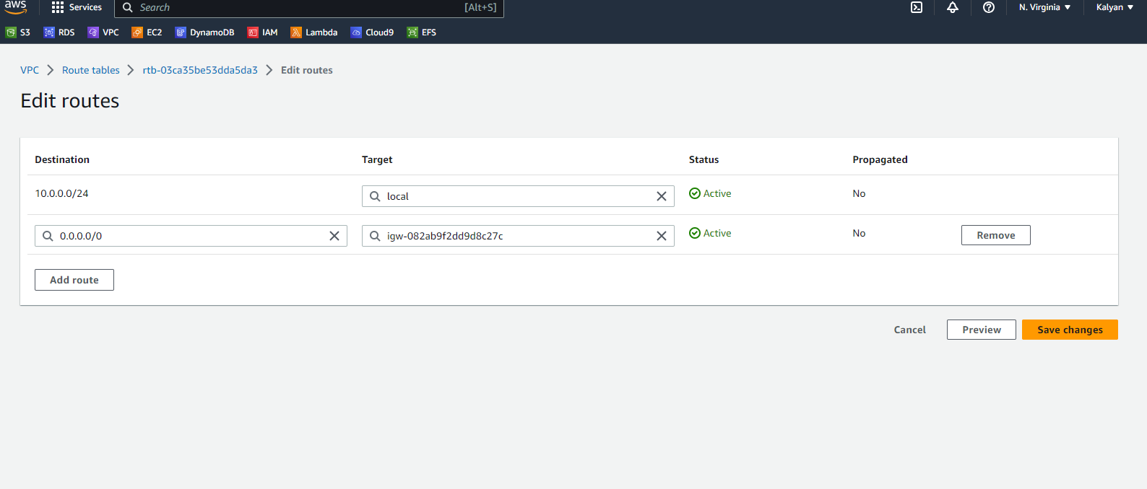
33
Edit routes in route table

Slide 37
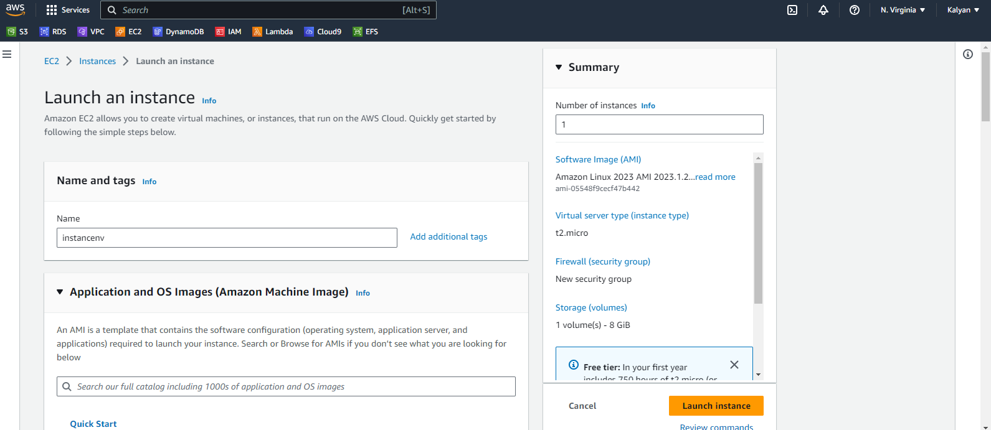
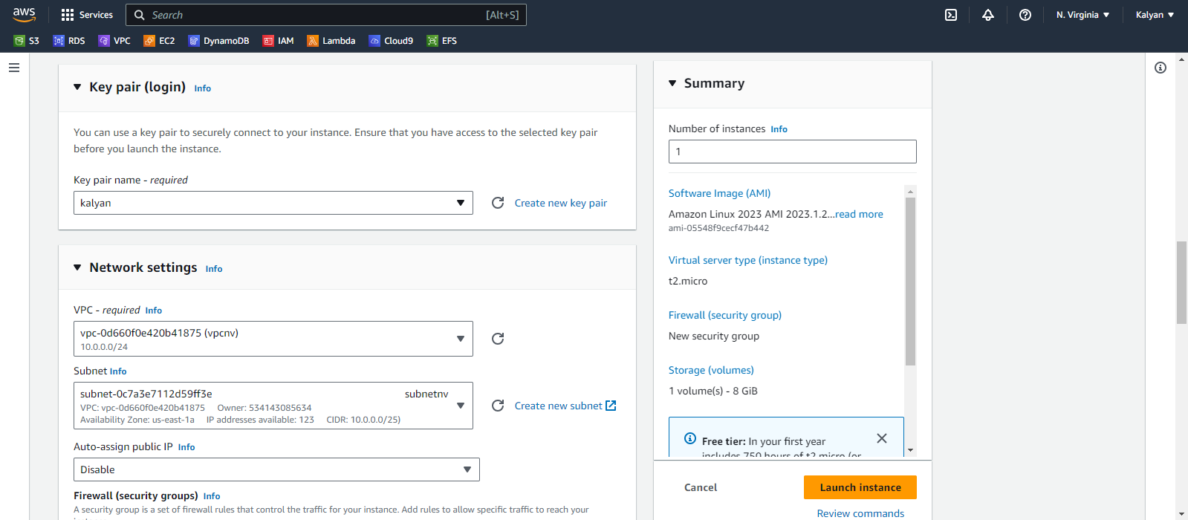
Service4:Launch an instance in n.virginia

Slide 38
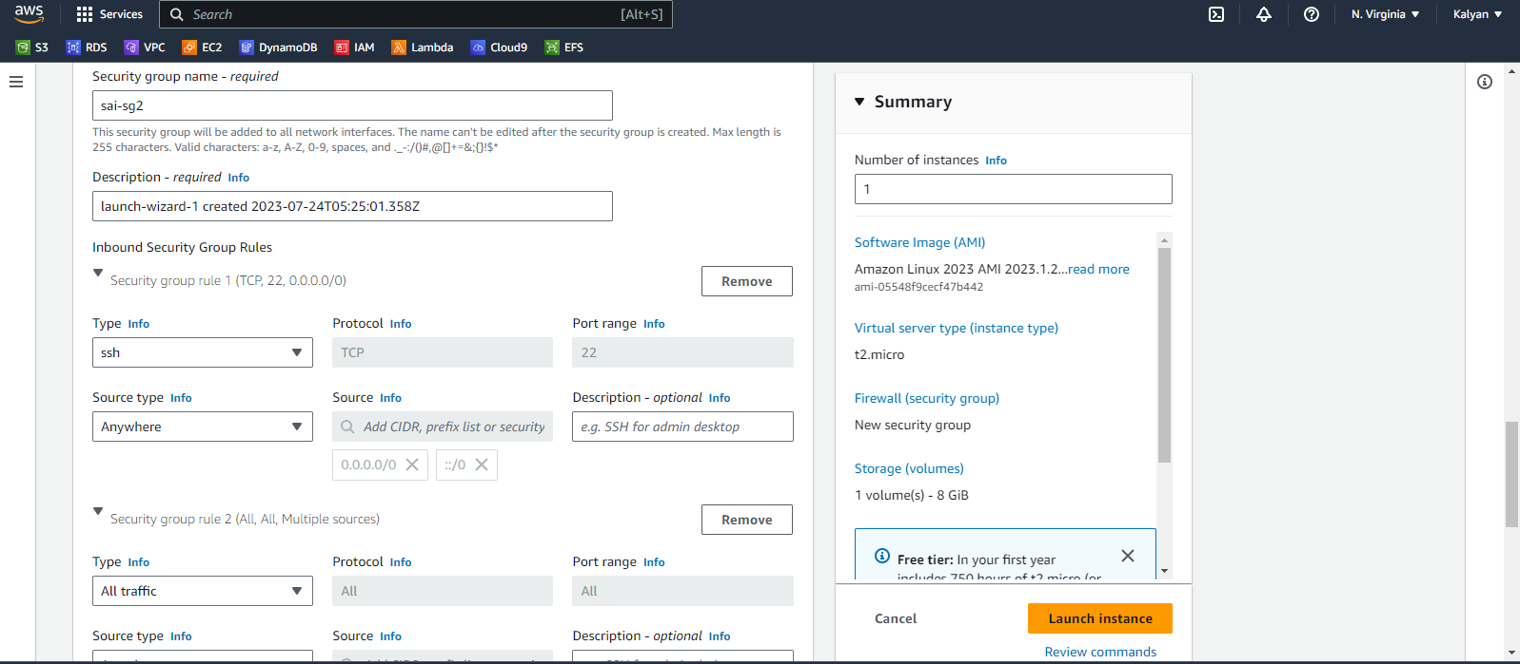
35

Slide 39
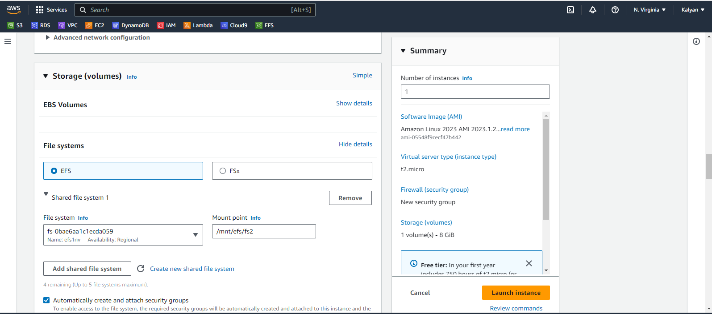
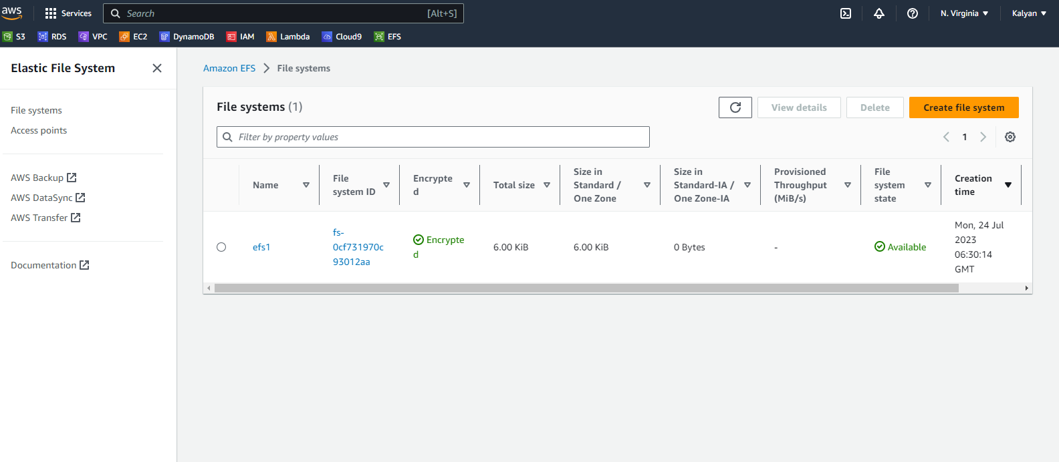
Service5:Create a new shared file system in instance
36
EFS is created

Slide 40
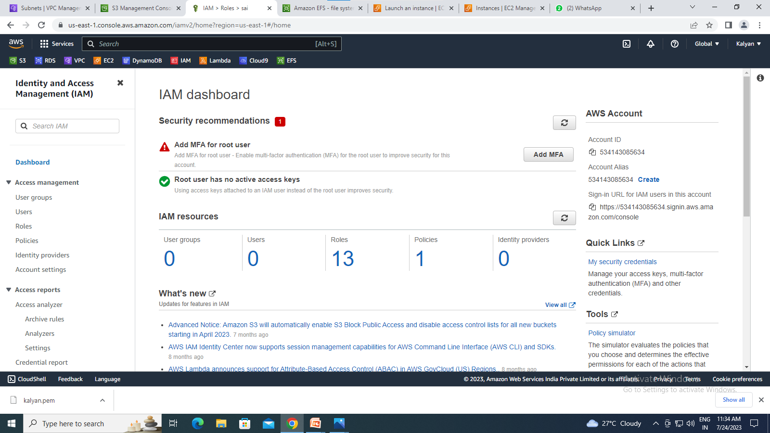
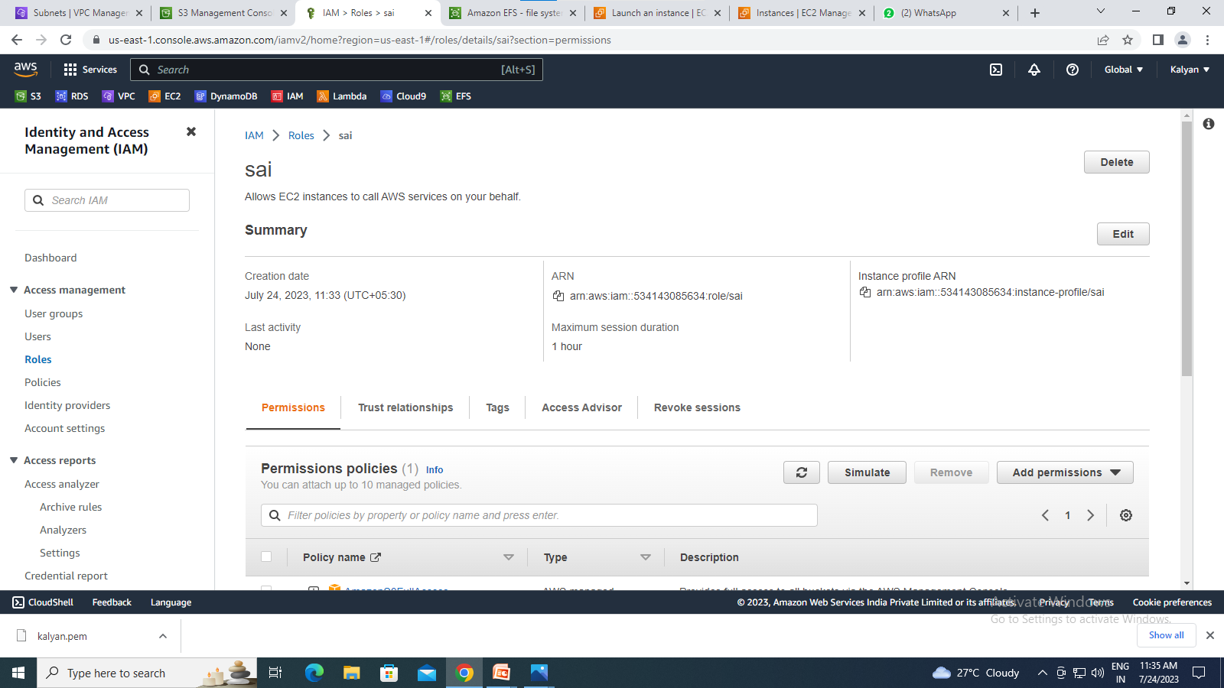
Service6:Create a role
37

Slide 41
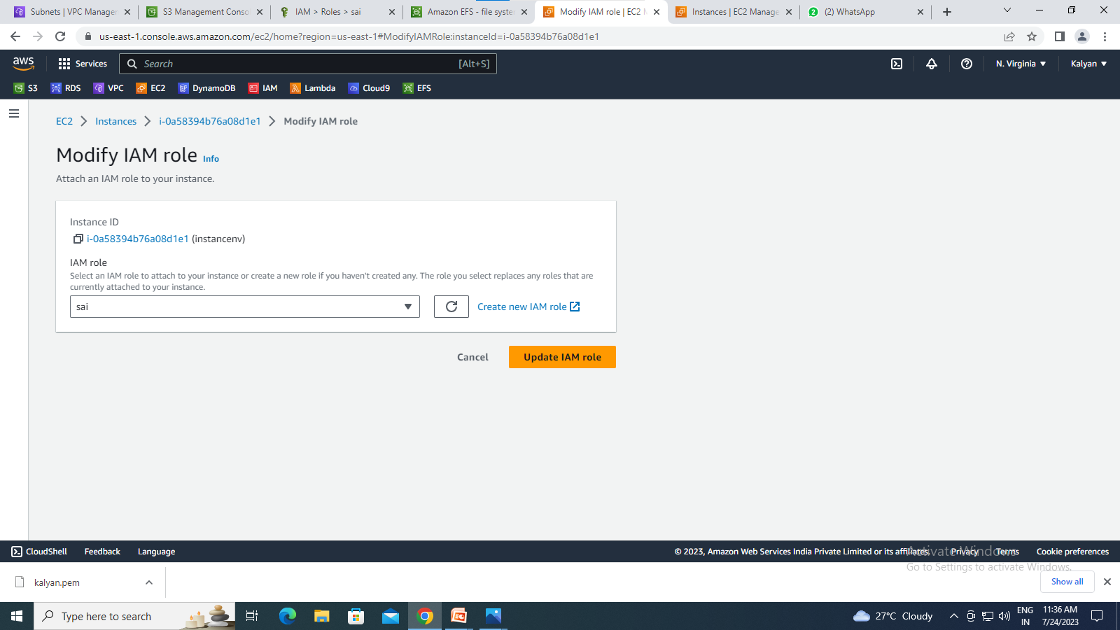
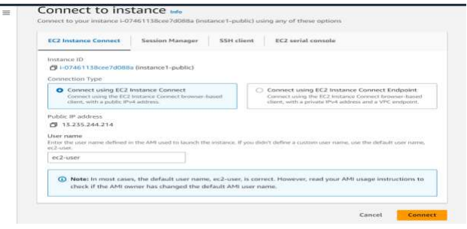
Attach IAM role to the instance
38
Connect to instance

Slide 42
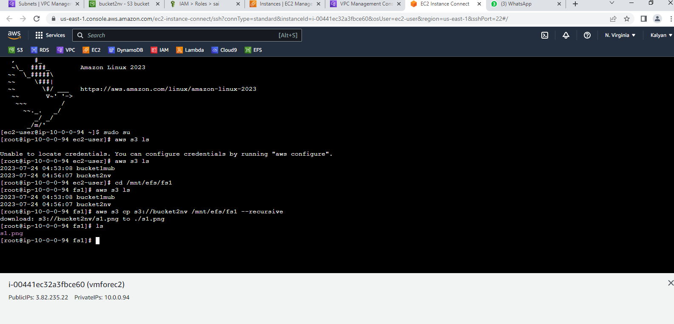
39
THANK YOU

